Slide 1
STEGANOGRAPHY & ENCRYPTION IN AUDIO FILES using LSB Algorithm
Submitted to-
Asso. Prof. R.S. Sharma
Presented by-
Aditi Sharma 10/151
Anand Singh 10/152
Ankit Goyal 10/153
Ankit Mohla 10/154
Arpit Hotwani 10/155

Slide 2
Introduction
Deals with 2 important concept
Steganography
Encryption

Slide 3
Steganography
Main Aim: Hiding data in between other files and providing a more secure environment.
To restrict unauthorized access to information
Transform the message so as to make it obscure to the person who intercepts.

Slide 4
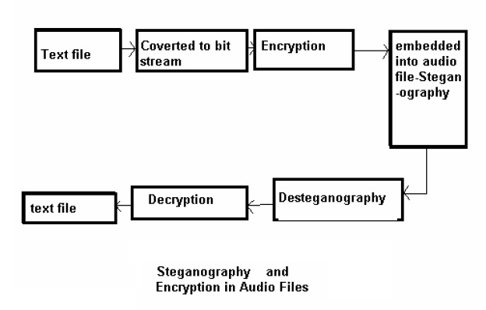
Block Diagram of Traditional Approach

Slide 5
PRINCIPLE OF STEGANOGRAPHY
Cover medium(wav file)
+
Hidden data(encrypted txt file)
+
Secret key(entered by user)
= stego_medium

Slide 6
Modules
Steganography
File Conversion
Encryption
Implementation of LSB Algorithm
De-steganography
Retrieval of cipher text from audio file by comparing the secret key
De-encryption

Slide 7
Module 1
ENCRYPTION

Slide 8
Modified Caesar Cipher
It is the simplest form of so called substitution cipher. The substitution in Caesar cipher is based on SHIFT operation done on letters of the plaintext. For example if the shift 3, then:
"CROSS THE RUBICON"
It is sent as:
"FURVV WKH UXELFRQ"

Slide 9
Module 2
FILE CONVERSION

Slide 10
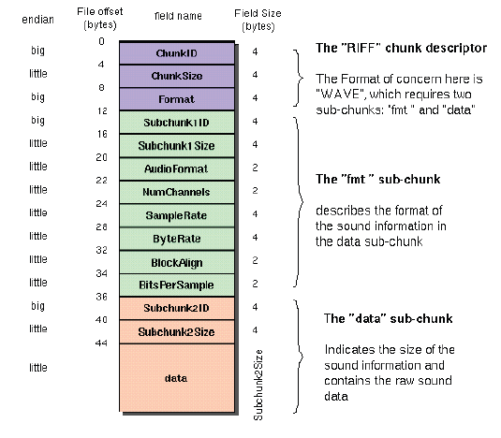
Canonical Wave File Format

Slide 11
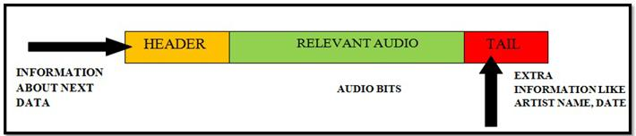
Canonical Mp3 File Format
Same data packet is repeated till the end of the file

Slide 12
Module 3
LSB ALGORITHM

Slide 13
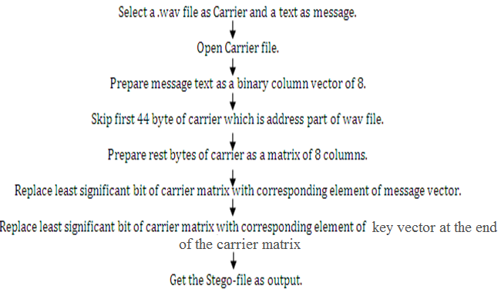
LSB Algorithm

Slide 14
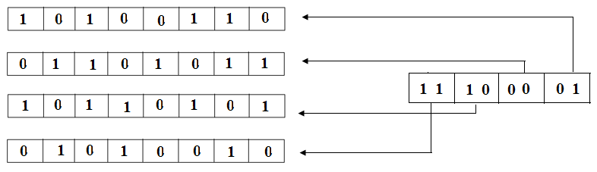
LSB Algorithm Block Diagram

Slide 15
Module 4
RETRIVAL OF CIPHER TEXT FROM AUDIO FILE

Slide 16
Steps in Module 4
Retrieve data chunk from output wav file.
Implement reverse of LSB algorithm to obtain byte array of encrypted message.
Obtain key from file to compare with the key given by the user.
Obtain least significant bits from the data and arrange in an array.
This array is the encrypted secret message.

Slide 17
Module 5
DECRYPTION

Slide 18
Comparison from traditional technique
Use of audio file steganography: traditionally either text or image steganography used.
More secure: Use of secret key in steganography while traditionally only encryption used key.
Double security: Encryption as well as steganography.

Slide 19
Applications of Steganography
Steganography is applicable to, but not limited to, the following areas.
Confidential communication and secret data storing
Protection of data alteration
Access control system for digital content distribution
Media Database systems
Used by intelligence agencies and terrorists for sending highly secure information.

Slide 20
THANK YOU

